Slide 1

DocuBridge.AI
Presented by HelloWorld

Slide 2


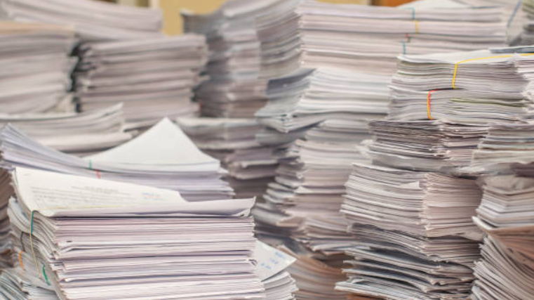
The Problem
Doctors spend an excessive amount of time manually writing pathology reports from EMRs, creating a redundant and frustrating workflow.

Slide 3
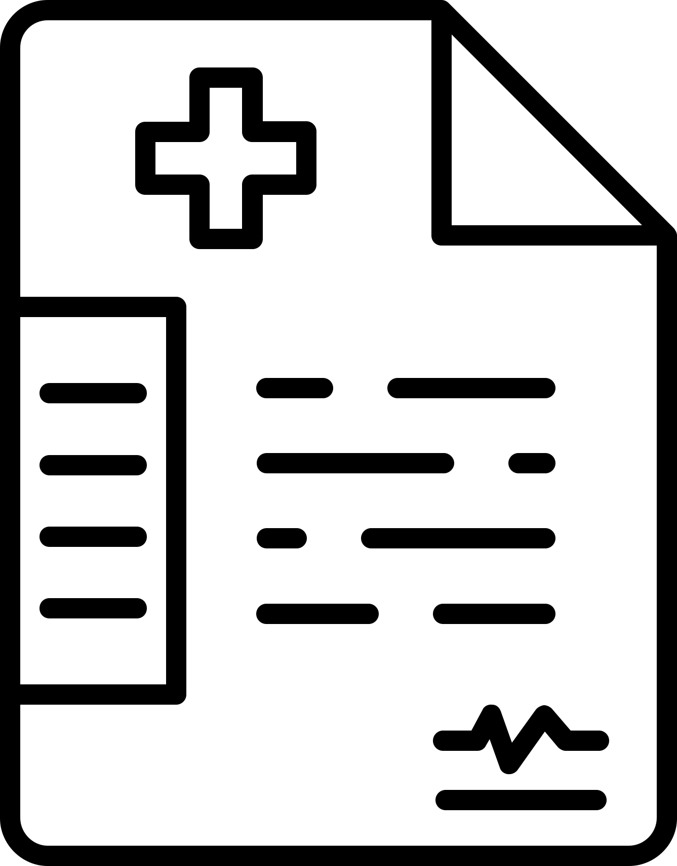


Transferable EMR Data Run Locally
Our Mission
Secure, localized platform for directly editing faxed medical records, enabling doctors to digitally type, sign, and manage documents without retyping.
This streamlines workflows, reduces redundancy, and ensures up-to-date, legible records—freeing up time for clinical care and supporting faster, informed decisions.
Secure Hospital-ID Login
Cedar OS Customizable AI Report
Healthcare Efficiency

Slide 4

1
Localized integration allows HCPs
to log in using their Hospital ID
2
Upload patient EMR for OCR-based data analysis
The Process
3
Unlimited report refinement
with side by side EMR view
4
Input patient details, clinical history,
laboratory results, and doctor notes
Exploring creativity
5
Finalize the report, download as PDF, and repeat!

